Slide 1
Non-contact Detection of Glucose Concentration – Monte Carlo Simulation
By R. Davis, M. Xu

Slide 2
Background
Glucose is an important molecule to metabolism: it is the primary way of transport of carbohydrates as well as important fuel in cells.
Diabetes mellitus is a group of diseases in which either:
The person does not produce enough insulin (Type I)
The cells do not respond to insulin that is produced (Type II)
Diabetes patients have to constantly prick themselves to check their blood sugar levels.

Slide 3
Type I vs. Type II
Type I :
Called the insulin-dependent diabetes mellitus or juvenile diabetes
Type II:
Related more to modern life style or adult diabetes
Constitutes >95% of all diabetic patients and effects over 25 million people in the US, and over 340 million in the world.

Slide 4
Current Invasive Solutions
Have to constantly monitor their glucose levels
Prick finger, drop onto to strip to insert into glucometer
Flux of the reaction creates an electric signal and responds to the electrical strength

Slide 5
The Problem
Accuracy
Reliability
Ultra-sensitivity
Fast Response
Low Cost Per Test

Slide 6
Current Solutions
Some Solutions:
Photo-acoustic Spectroscopy
Optical Coherence Tomography (OCT)
Scattering
Other Less Successful Solutions:
Cnoga Medical Ltd. - Combo Glucometer
Oculir
Integrity Applications Ltd.

Slide 7
Photo-Acoustic Spectroscopy
Conversion from optical to acoustic energy through a multi-stage conversion using a piezoelectric detector.
Change in photoacoustic pulse was found when concentration was altered.
Alexander Graham Bell – 1880
Discs emitted sound when exposed to sunlight that was rapidly interrupted

Slide 8
Optical Coherence Tomography (OCT)
Using an interferometer with a light that is aimed at the subject, the light that backscatters from structures within the tissue
Interferes with the light from the reference arm. This method is based on a phenomenon in which the increase of glucose concentration in the blood decreases the scattering coefficient
Increase in extracellular glucose concentration makes the refractive index increase
Decrease in overall scattering coefficient

Slide 9
Problem With Current Solutions
Photo-acoustic Spectroscopy:
Require specific wavelength per subject therefore inefficient since the technique has to be personalized
OCT
Too many changing variables such as cell size, which keep the results inconsistent
Scattering
Has not been conducted on human experiments yet
Other substances presented in skin could confound results

Slide 10
CNoga Medical Ltd – Como Glucometer
Four LED’s with range of 650 – 1150 nm
Due to absorption when light passes the fingertip the spectrum detected also changes
Analyzes signal and extracts bio parameteres

Slide 11
Oculir
Infrared laser pointed at the sclera (the white structure of the eye)
The laser beam is reflected from membranes and vessels inside the eye ball back to the detector.
Glucose has a high absorption rate of mid infrared radiation.
The light reflected back to the device is proportional to the glucose concentration in the blood

Slide 12
Integrity Applications Ltd.
Three Real Time Technologies:
Ultrasonic
Electromagnetic
Thermal
Each technology measures different bio-parameters that change according to the change in glucose concentration

Slide 13
Three Main Optical Methods for Detecting Glucose
Absorption
Scattering
Polarization

Slide 14
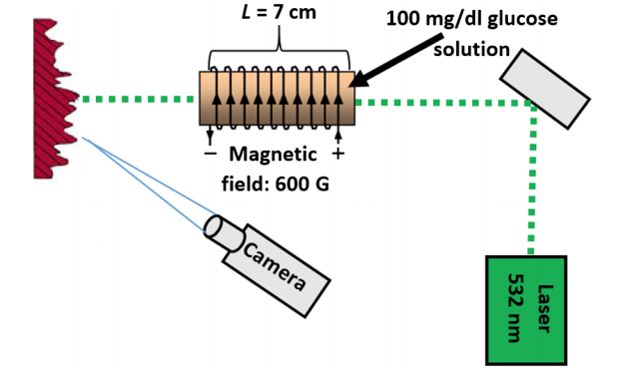
Polarization Effect – Speckle Based
Optical sensor based on the magneto optic effect
Uses the rotation of polarized light which passes through the medium subject to a magnetic field
The linear polarization will rotate because of the Faraday Effect due to Glucose
The Speckle field of the backscatter light changes

Slide 15
The Problem
Although the polarization effect is small its clean. Therefore we would like to investigate quantifying it.

Slide 16
What is the Monte Carlo Simulation?
Computerized mathematical technique that allows people to account for risk in:
Quantitative analysis
Decision making
Able to change variables to better simulate situations and how they occur based on variable change
First used during the production of the atom bomb – named after the city Monte Carlo in Monaco.
Used in fields such as:
Business
Science
Mathematics
Engineering

Slide 17
Monte Carlo Simulation Optical Detection of Glucose
Trace photons ( Electric field and the propagation direction) by Monte Carlo Approach
E
E
E
Notes:
Glucose is biofringe material. Different regraftive index for both polarizations

Slide 18
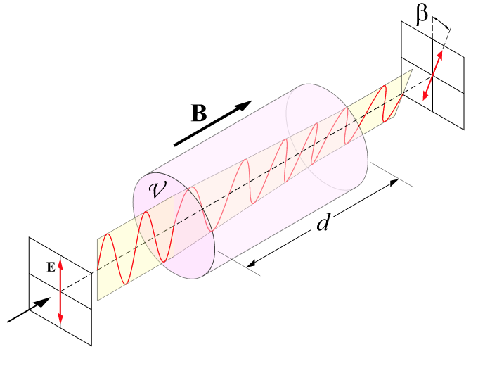

Incorporating Faraday Rotation by Glucose
The foundation for the detection:
$$θ= θBL$$

Slide 19

The Verdet Constant and its Importance
The foundation for the detection:
$θ= θBL$
Optical constant that describes the strength of the Faraday effect for a particular material
The Verdet constant for most materials is extremely small and is wavelength dependent
The Faraday effect is chromatic and quite influenced by the wavelength
For our use:
$θ=3.94\frac{rad}{Tesla ∗m}$

Slide 20
Goals and Timeline
Within one year of time we would like to:
1.) Write the code for the Monte Carlo simulation incorporating Faraday rotation effects. Approx. 3 months.
2.) Simulate the detection of Glucose with the Monte Carlo code. Approx. 2 month.
3.) Write Report on the results of the project. Approx. 1 month.
4.) Time permitting repeat the process through actual experimentation. Approx. Time permitting.

